Slide 1
Module 7: Object-Oriented Detailed Design
Software Engineering
Faculty of Computing,
Universiti Teknologi Malaysia

Slide 2
Objectives
To understand the relationship among analysis, design and implementation
To comprehend object-oriented design principles
To further understand object-oriented design using UML
To elaborate the related diagrams from analysis in design phase in use case realization
References: Sommerville (2016), Arlow and Neustadt (2002), Satzinger (2011)

Slide 3
RELATIONSHIPS AMONG ANALYSIS, DESIGN AND IMPLEMENTATION
Objective 1:

Slide 4
Design and Implementation
Software design and implementation is the stage in the software engineering process at which an executable software system is developed
Software design and implementation activities are invariably inter-leaved:
Software design is a creative activity that identifies software components and their relationships, based on a customer’s requirements
Implementation is the process of realizing the design as a program

Slide 5
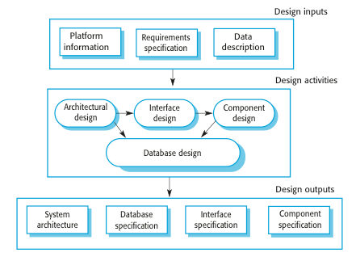
Recap on Design Stage

Slide 6
Object-Oriented Design Process
Structured object-oriented design processes involve developing a number of different system models
They require a lot of effort for development and maintenance of these models and for small systems, this may not be cost-effective
However, for large systems developed by different groups, design models are an important communication mechanism

Slide 7
OBJECT-ORIENTED DESIGN PRINCIPLES
Objective 2:

Slide 8
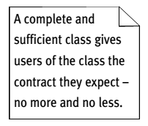
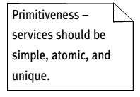
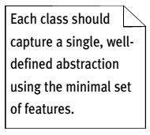
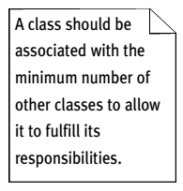
Well-Formed Design Class
Four minimal characteristics that a design class must have to be considered well-formed:
complete and sufficient
primitive
high cohesion
low coupling
Source: Arlow and Neustadt (2002)

Slide 9
Some Fundamental Design Principles…
Encapsulation
Each object is a self-contained unit containing both data and program logic
Object reuse
Standard objects can be used over and over again within a system
Information hiding
Data associated with an object is not visible
Methods provide access to data

Slide 10
Some Fundamental Design Principles
Navigation visibility
Describes which objects can interact with each other
Coupling
Measures how closely classes are linked
Cohesion
Measures the consistency of functions in a class
Separation of responsibilities
Divides a class into several highly cohesive classes

Slide 11
Coupling and Cohesion of Subsystems
Good Design
Goal: Reduce system complexity while allowing change
Coherence measures dependency among classes
High cohesion: The classes in the subsystem perform similar tasks and are related to each other via associations
Low cohesion: Lots of miscellaneous and auxiliary classes, no associations
Coupling measures dependency among subsystems
High coupling: Changes to one subsystem will have high impact on the other subsystem
Low coupling: A change in one subsystem does not affect any other subsystem
Source: Bennett et al. (2010)

Slide 12
Example of a Bad Subsystem Decomposition
User Interface
Component Management
Advertisement
Tournament
Tournament Statistics
Why is this a bad design?
Discuss in terms of cohesion and coupling.
Session Management
User Management
Source: Bennett et al. (2010)

Slide 13
How to Achieve High Cohesion
High cohesion can be achieved if most of the interaction is within subsystems, rather than across subsystem boundaries
Questions to ask:
Does one subsystem always call another one for a specific service?
Yes: Consider moving them together into the same subsystem
Which of the subsystems call each other for services?
Can this be avoided by restructuring the subsystems or changing the subsystem interface?
Notes:
What kind of model is good for describing layers and partitions? UML Class diagrams!

Slide 14

How to Achieve Low Coupling
Low coupling can be achieved if a calling class or interface does not need to know anything about the internals of the called class (Principle of information hiding, Parnas)
Questions to ask:
Does the calling class really have to know any attributes of classes in the lower layers?
Is it possible that the calling class calls only operations of the lower level classes?
David Parnas, *1941,
Developed the concept of
modularity in design
Notes:
What kind of model is good for describing layers and partitions? UML Class diagrams!

Slide 15
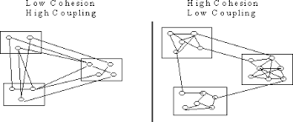
Comparison
Bad
Good

Slide 16
OBJECT-ORIENTED DESIGN MODELS USING UML
Objective 3:

Slide 17
Design Models Artefacts
Design model involves an elaboration of the analysis model where we add detail and specific technical solutions
The design model contains the same sorts of things as the analysis model, but all the artefacts are more fully formed and must now include implementation details
E.g. An analysis class may be little more than a sketch with few attributes and only key operations (or just a domain model)
A design class, however, must be fully specified – all attributes and operations (including return types and parameter lists) must be complete

Slide 18
Design Models: UML Diagrams
Design subsystems 🡺 Package Diagram
Design classes 🡺 Class Diagram also known as Design Class Diagram
Interfaces 🡺 Component Diagram (as discussed in Module 6: Architectural Design)
Use case realizations 🡺 Sequence Diagram also known as Design Sequence Diagram (and its relation to Design Class Diagram)
Deployment diagram (implementation)

Slide 19
Design Models (our focus)
Design subsystems 🡺 Package Diagram
Design classes 🡺 Class Diagram
Interfaces (already discussed in Module 6)
Use case realizations 🡺 Sequence Diagram
Deployment diagram (implementation)

Slide 20
Object-Oriented Design Models
Identify all objects that must work together to carry out a use case
Package diagrams denote which classes work together as a subsystem
Divide objects into groups for a multilayer design
Sequence diagrams describe the messages that are sent between objects
Design class diagrams document and describe the programming classes (implementation)
Design information is primarily derived from domain model and sequence diagram from the analysis stage

Slide 21
DESIGN SUBSYSTEMS: PACKAGE DIAGRAM
Design subsystems 🡺 Package Diagram
Design classes 🡺 Class Diagram
Use case realizations 🡺 Sequence Diagram
Deployment diagram (implementation)

Slide 22
Package Diagram: Structuring the Major Components
Associate classes of related groups or related use case
One option is to separate the view, domain, and data access layers into separate packages
Indicate dependency relationships:
Shows which elements affect other elements in a system
May exist between packages, or between classes within packages
Packages can be nested

Slide 23
Multilayer Design
Focus on a basic multilayer design that consists of the view layer realization of use cases specification of all detailed system processing for:
User interface classes
Domain layer (problem domain classes from the domain model class diagram), controller classes
Data layer (database access classes)

Slide 24
Heuristics to Identify Subsystem
Assign objects identified in one use case into the same subsystem
Minimize the number of associations crossing subsystem boundaries
All objects in the same subsystem must be functionally related
Source: Bennett et al. (2010)

Slide 25
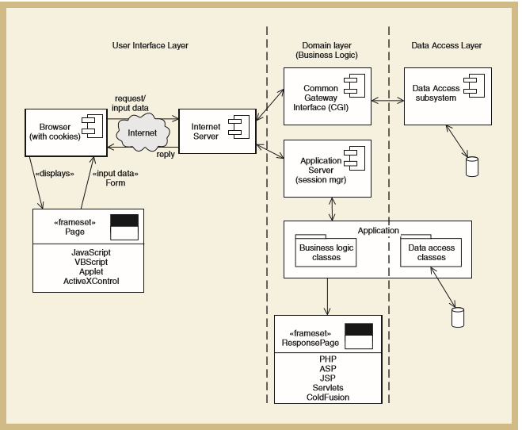
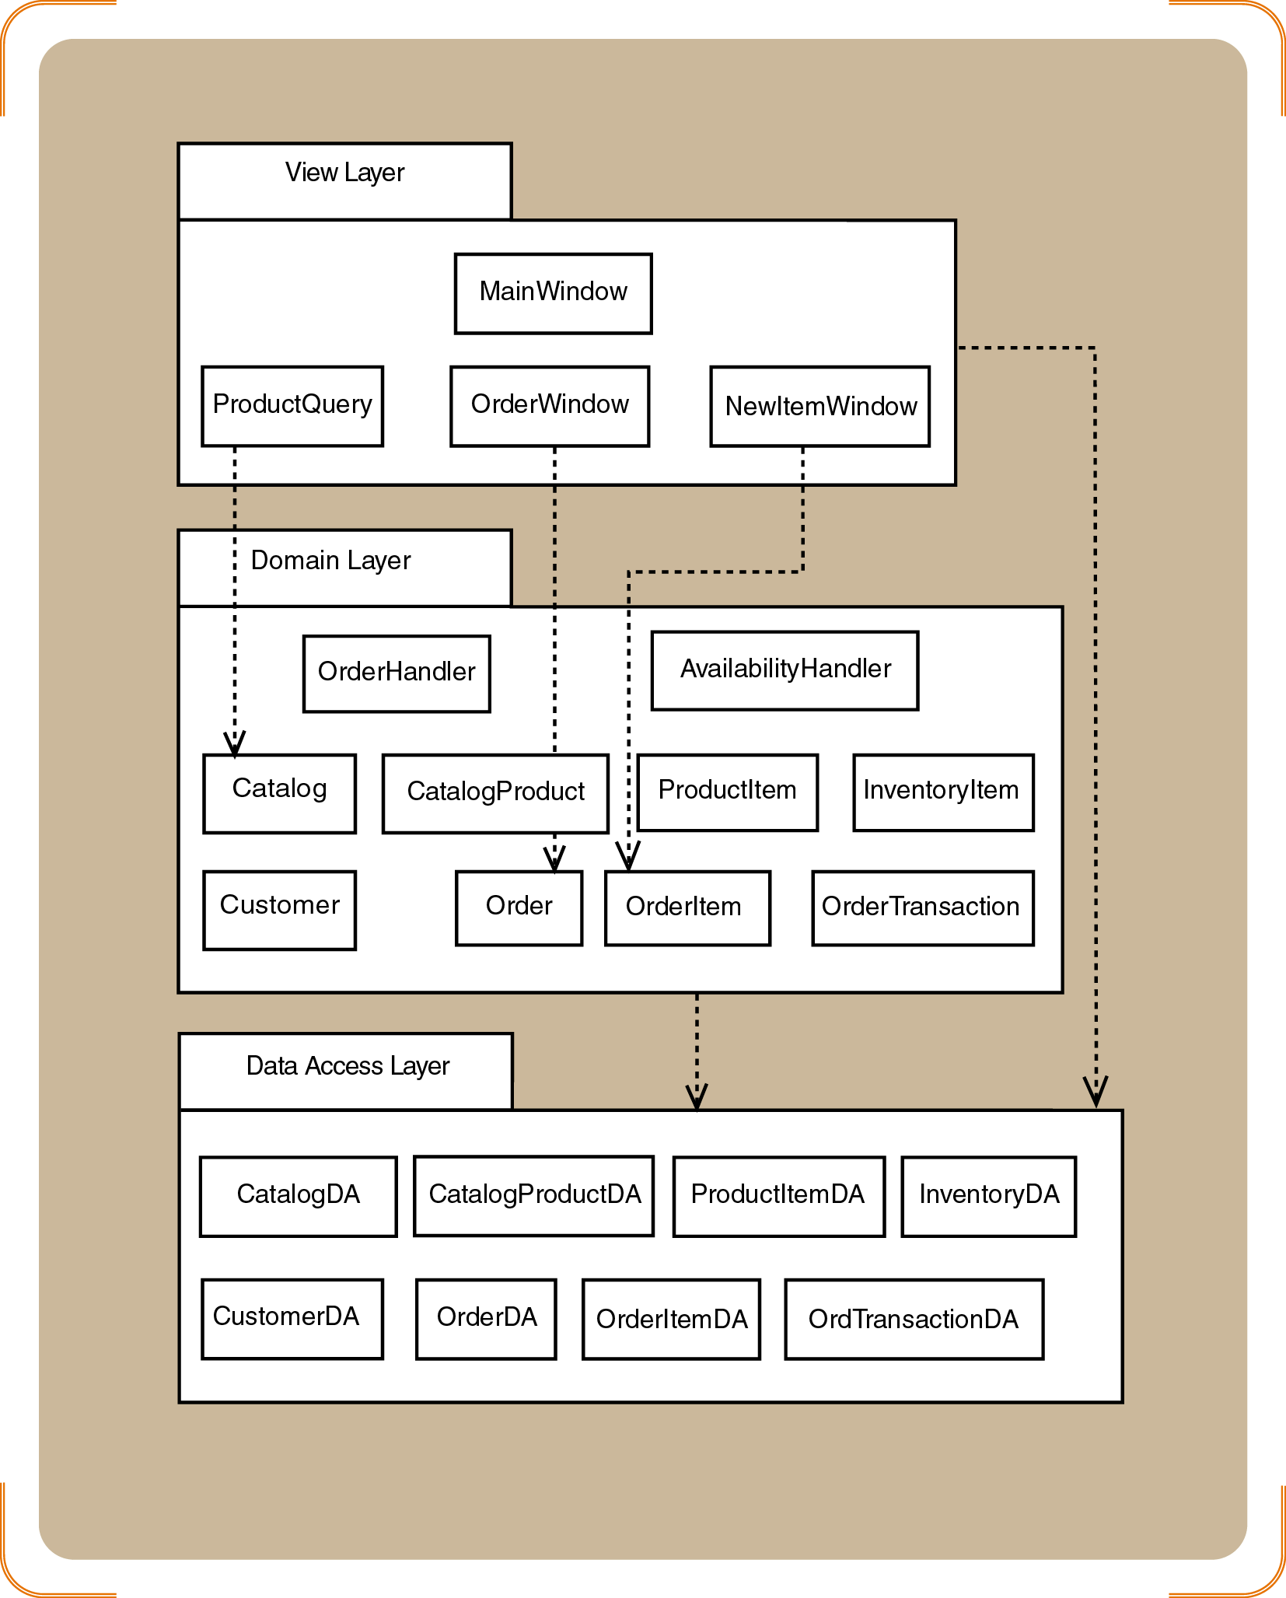
Example of Design Subsystems: Combination of Layered (user interface, domain layer and data access layer), Subystems and Components
Note: Observe how package diagram and component diagram are included in the layered architectural style as discussed in Module 6

Slide 26
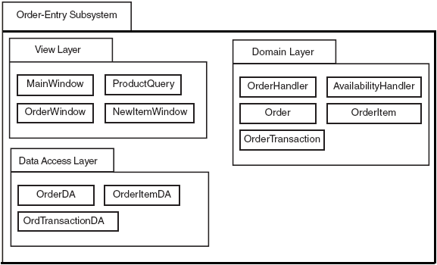
Example: Three-Layer Package Diagram for Order-Entry Subsystem
Note: Domain Layer also includes the controllers (OrderHandler and AvailabilityHandler)

Slide 27
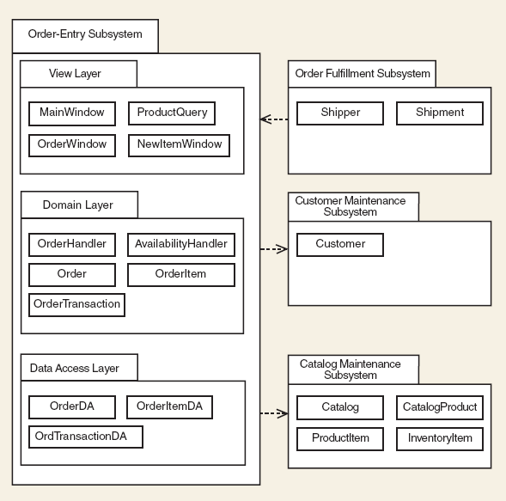
Example: Order Entry Subsystem and the interaction with other subsystems

Slide 28
DESIGN CLASSES: CLASS DIAGRAM
Design subsystems 🡺 Package Diagram
Design classes 🡺 Class Diagram
Use case realizations 🡺 Sequence Diagram
Deployment diagram (implementation)

Slide 29
Anatomy of a Design Class
In analysis, we just capture the required behaviour of the system without worrying at all about how this behaviour is going to be implemented
In design, we have to specify exactly how the class will fulfil its responsibilities by doing the following:
Complete the set of attributes and fully specify them including name, type, visibility and (optionally) a default value
Turn the operations specified in the analysis class into a complete set of one or more methods
Note: In our SE scope, we only produce domain model in analysis without operations

Slide 30
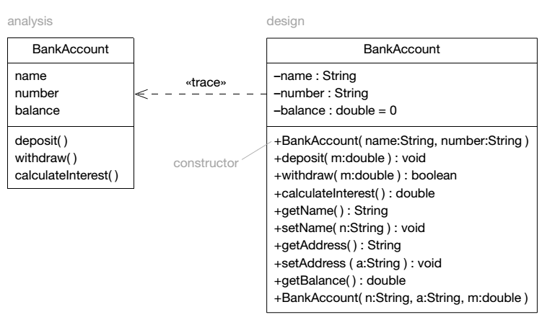
Analysis vs. Design Class
Note: In our SE scope, we only produce domain model in analysis without operations

Slide 31
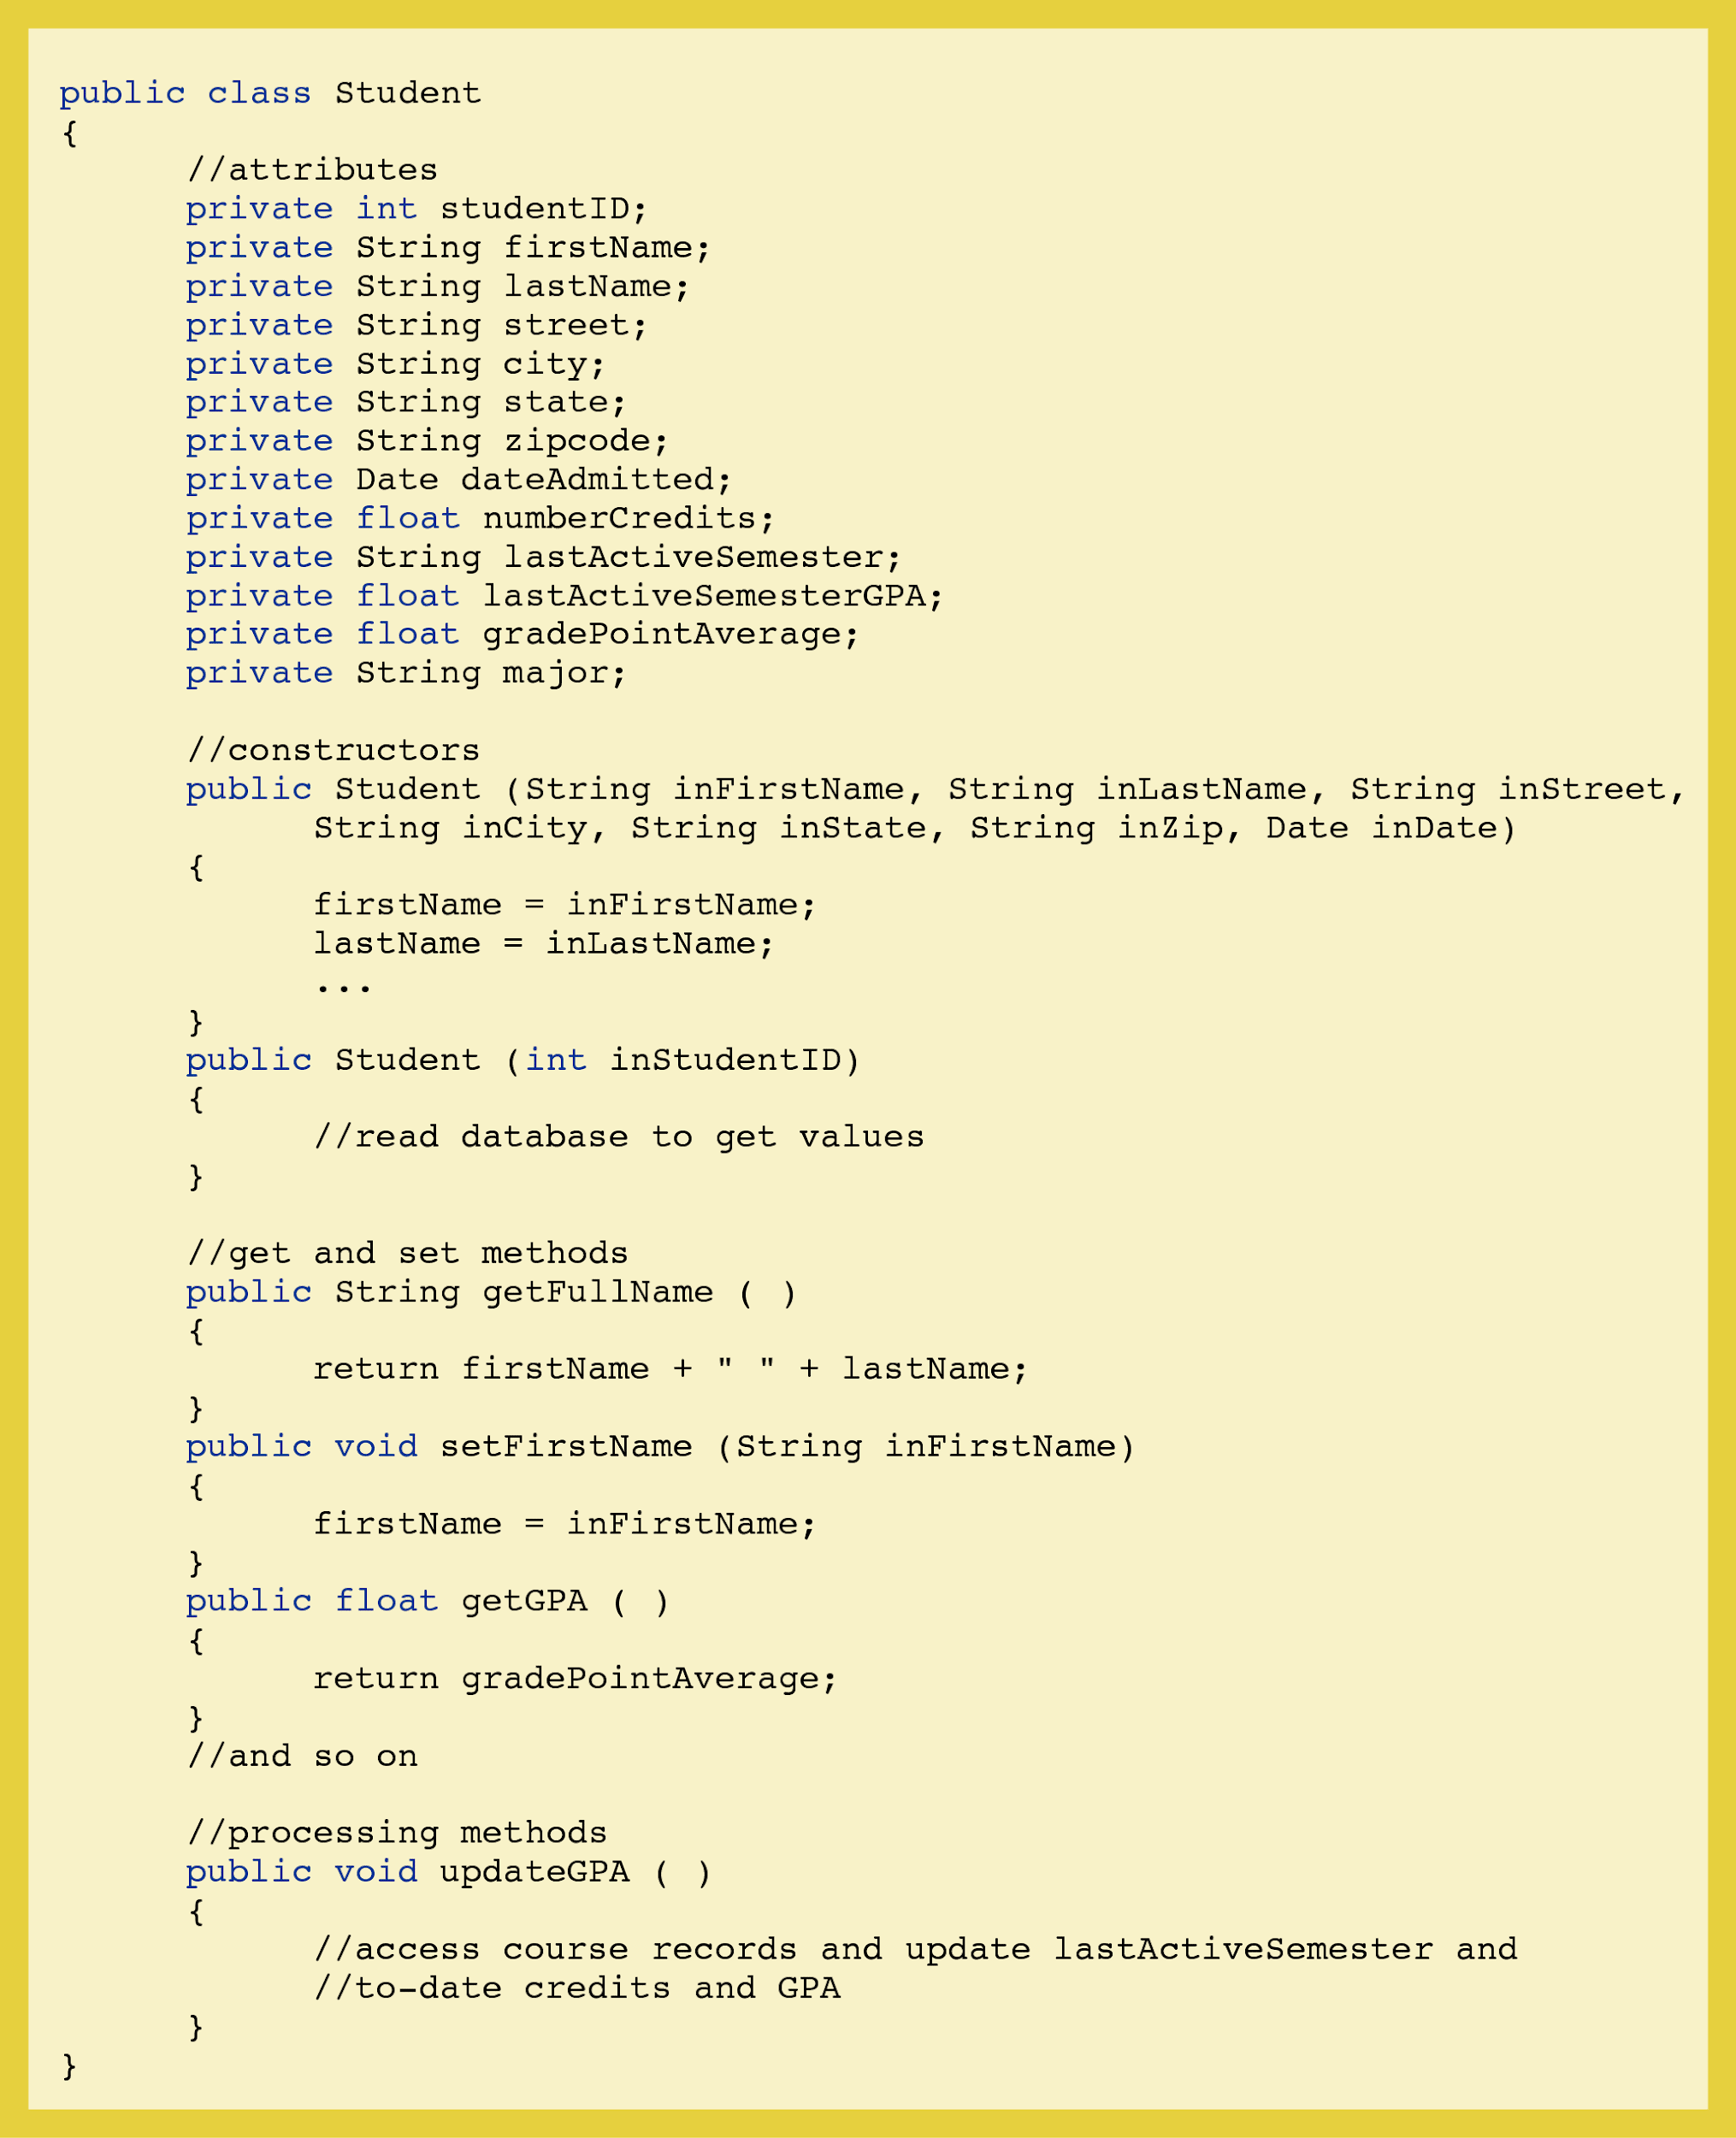
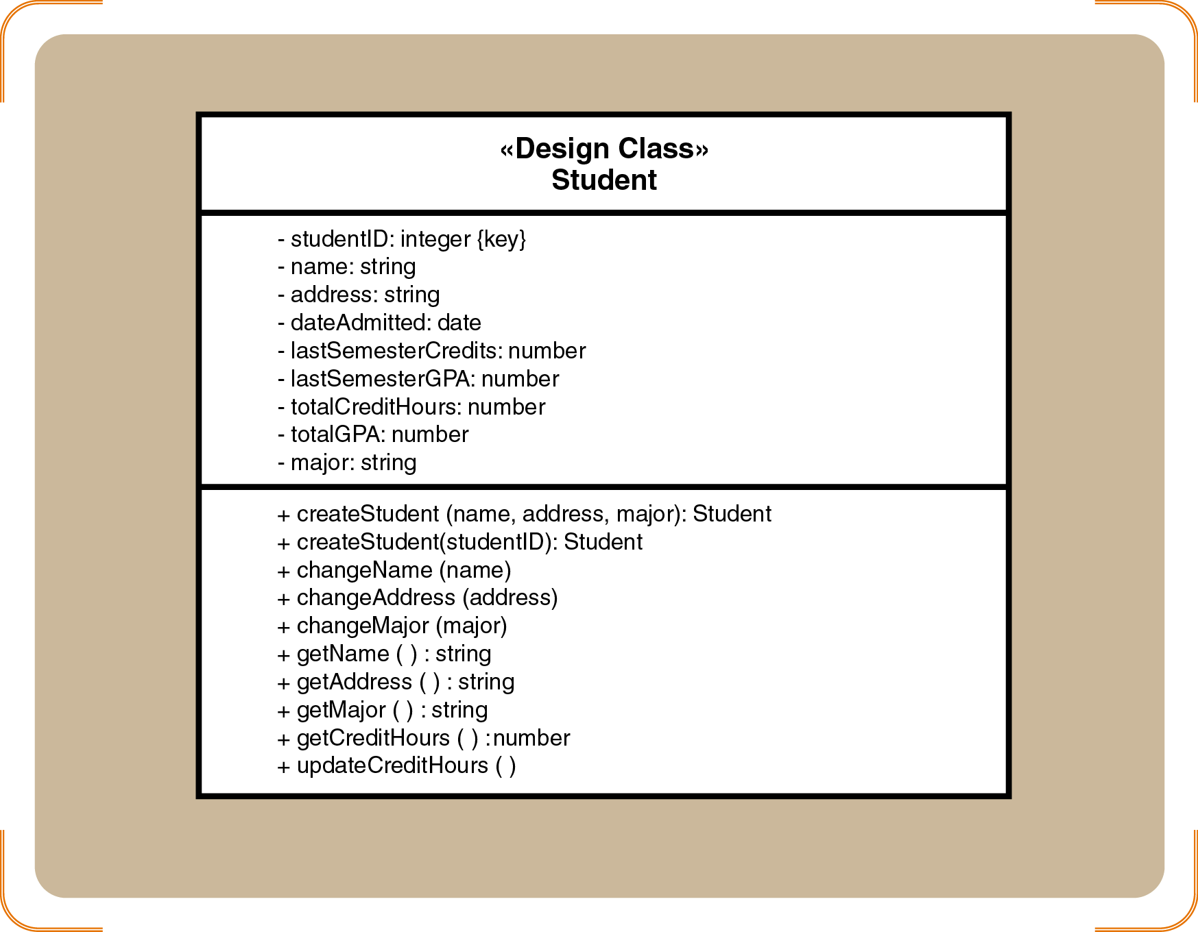
Design vs. Implementation

Slide 32
Design Class Symbols Using Stereotypes
Stereotypes
UML notation to categorize a model element as a certain type
Two types of notation
Full notation with guillemets («»)
Shorthand notation with circular icons
Standard stereotypes
Entity, control, boundary, data access
Note: This concept has been introduced in the analysis stage

Slide 33
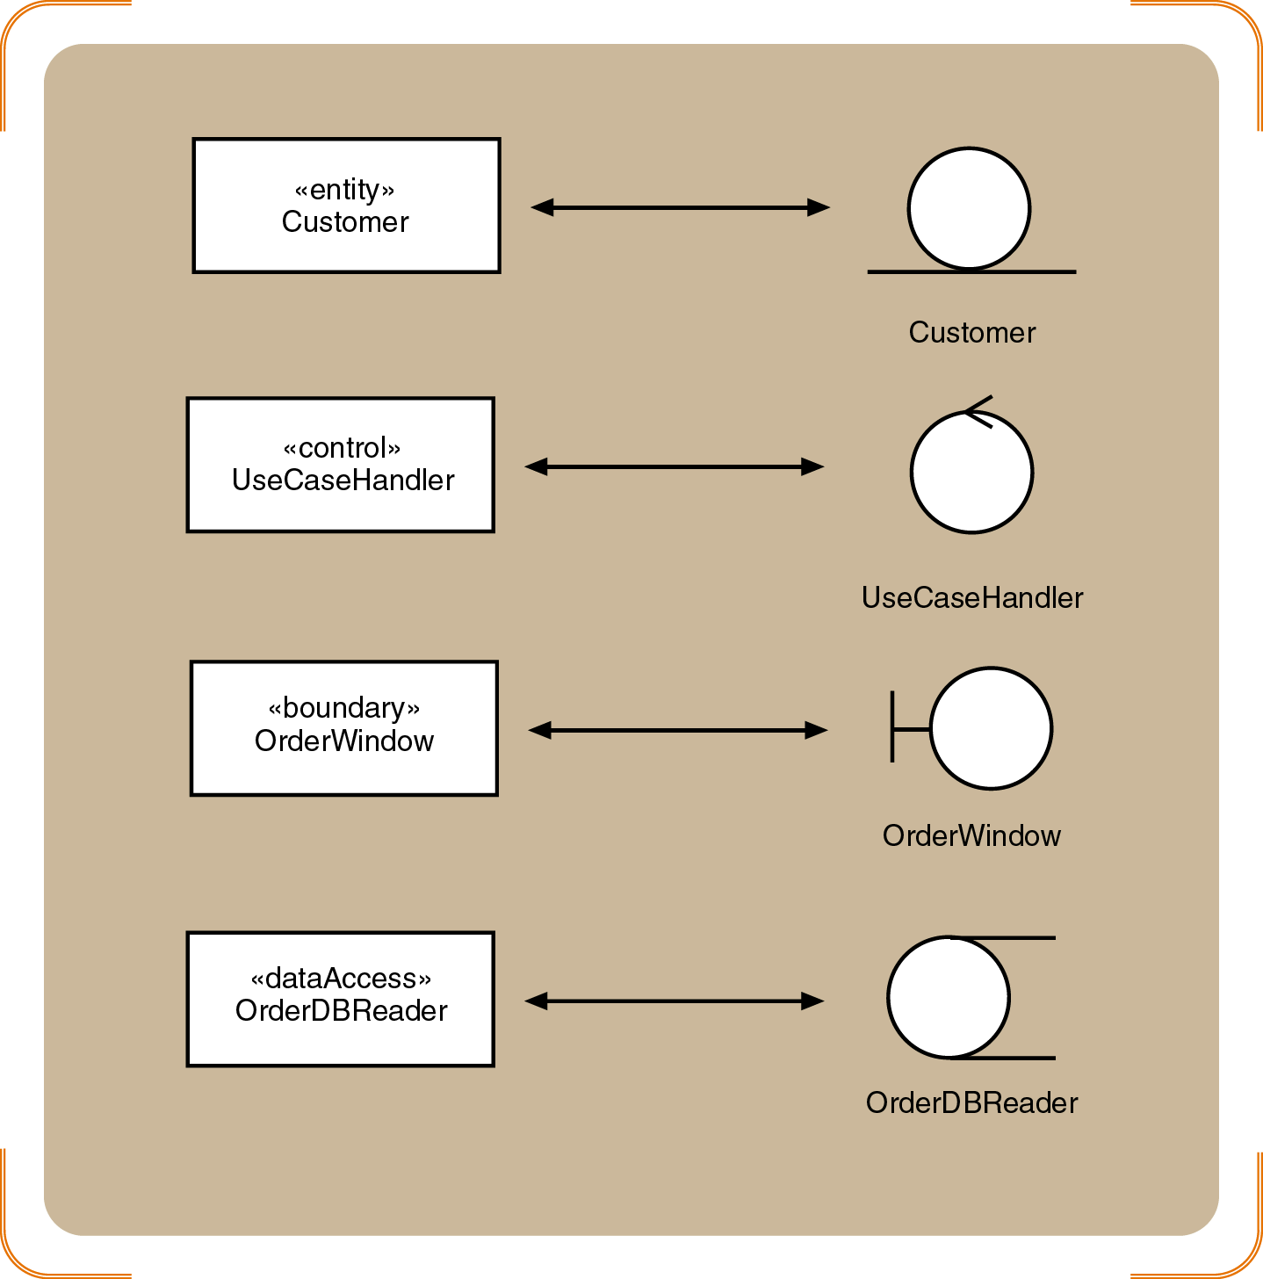
Standard Stereotypes in Design Models
Shorthand notation
Full notation

Slide 34
Design Class Notation
Class name and stereotype information
Attribute information
Visibility, type-expression, name, initial value, and properties
Method signature
Visibility, name, type-expression, and parameter list
Use the entire signature to identify a method to distinguish between overloaded methods

Slide 35
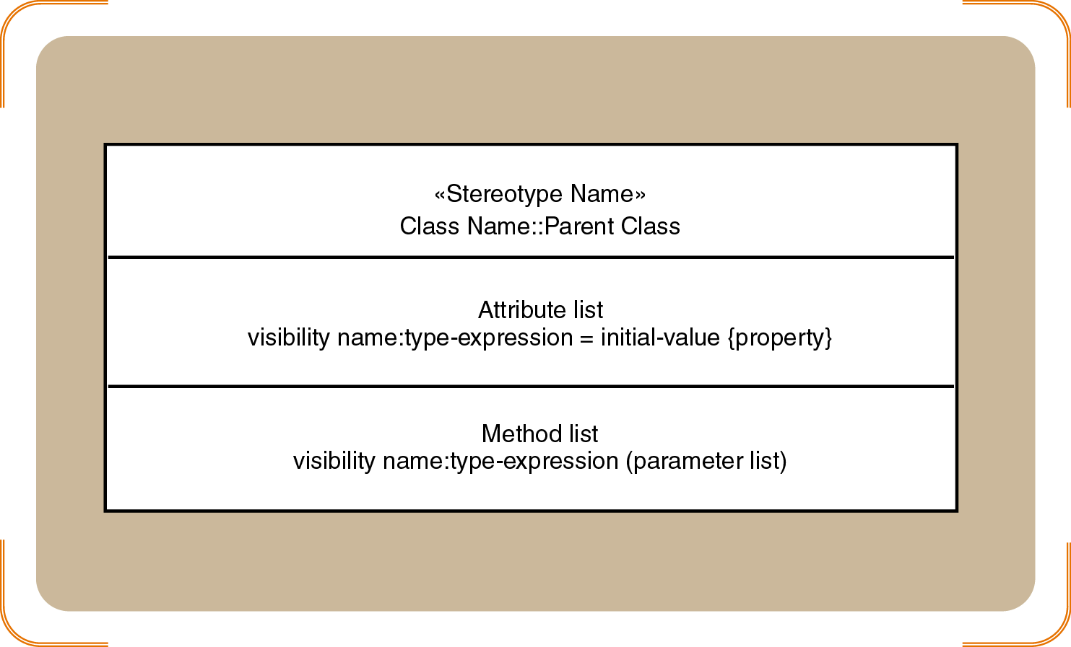
Internal Symbols and Example

Slide 36
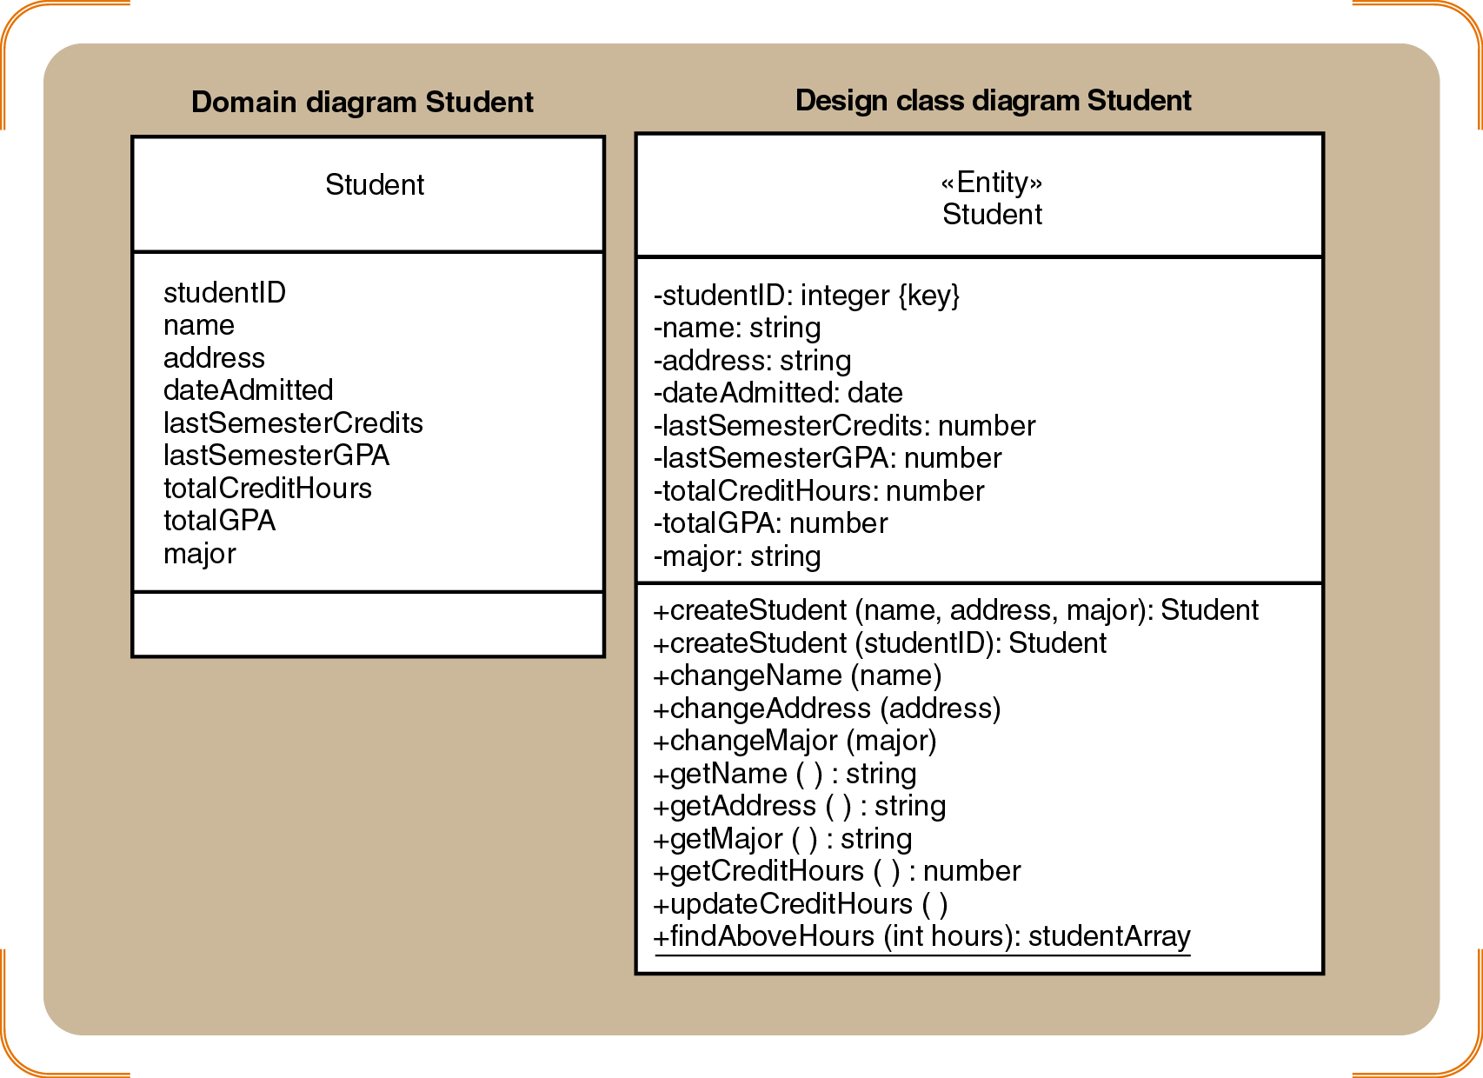
Domain Model vs. Design Class Diagram
Student class examples for the domain diagram and the design class diagram

Slide 37
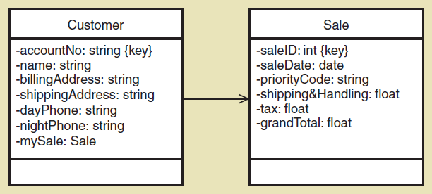
Navigation Visibility
The ability of one object to view and interact with another object accomplished by adding an object reference variable to a class
Shown as an arrowhead on the association line—customer can find and interact with sale because it has mySale reference variable

Slide 38
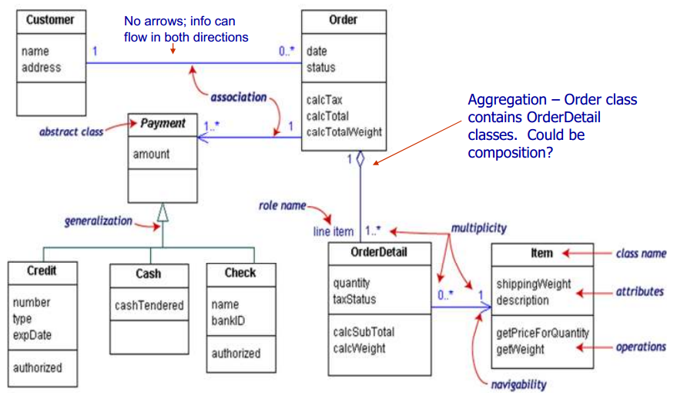
Example of Class Diagram with Navigability
Source: https://softwareengineering.stackexchange.com/questions/195614/uml-class-diagram-confusion?noredirect=1&lq=1

Slide 39
USE CASE REALIZATIONS: SEQUENCE DIAGRAM
Design subsystems 🡺 Package Diagram
Design classes 🡺 Class Diagram
Use case realizations 🡺 Sequence Diagram
Deployment diagram (implementation)

Slide 40
Interaction Diagrams: Realizing Use Cases and Defining Methods
Interaction diagrams are at the heart of object-oriented design
Realization of a use case:
Determine what objects collaborate by sending messages to each other
Two types:
Sequence (Our focus)
Communication

Slide 41
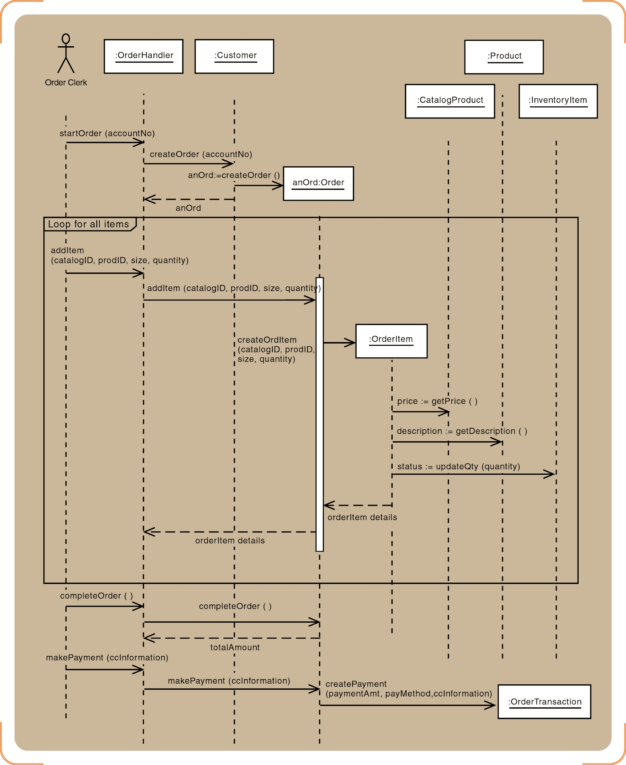
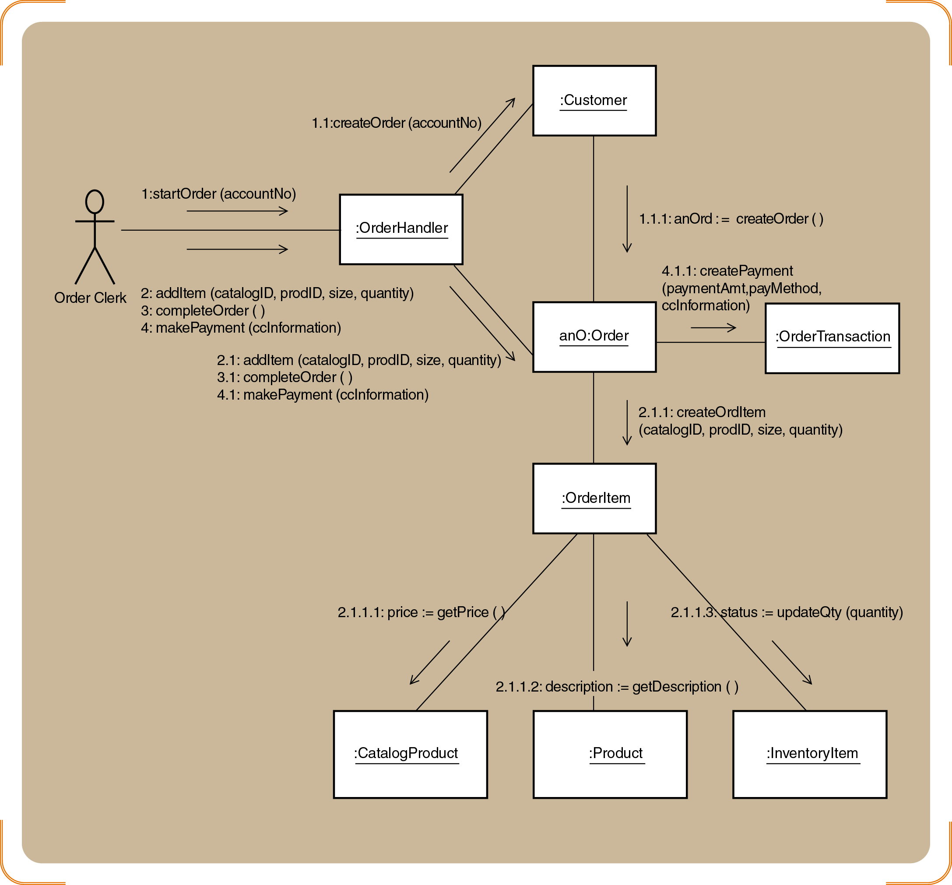
Interaction Diagrams: Sequence and Collaboration (will be elaborated in use case realization)
Our focus

Slide 42
DEPLOYMENT DIAGRAM (IMPLEMENTATION)
Design subsystems 🡺 Package Diagram
Design classes 🡺 Class Diagram
Use case realizations 🡺 Sequence Diagram
Deployment diagram (implementation)

Slide 43
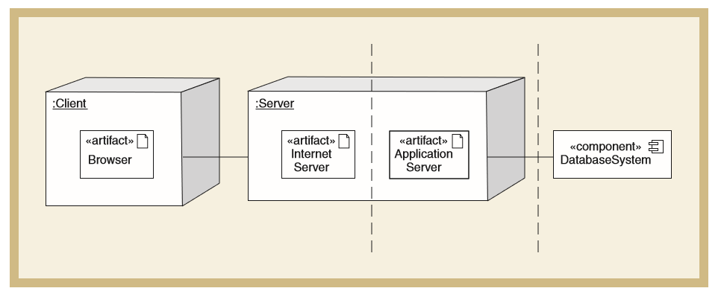
Example: Deployment Diagram for an Internet Based System
A deployment diagram shows the placement of various physical nodes (components) across different locations
A node can be thought of as a computer, or a bank of computers, representing a single computing resource
Satzinger (2011)

Slide 44
Component Diagrams vs. Deployment Diagrams
Component Diagrams
Deployment Diagrams
Component diagrams focus on logical components
Component diagrams show the various executable components of the new system and how they relate to each other
deployment diagrams focus on physical components
Deployment diagrams show how and where the components are executed on various computing platforms. Together they define the system’s configuration

Slide 45
USE CASE REALIZATION
Objective 4:

Slide 46
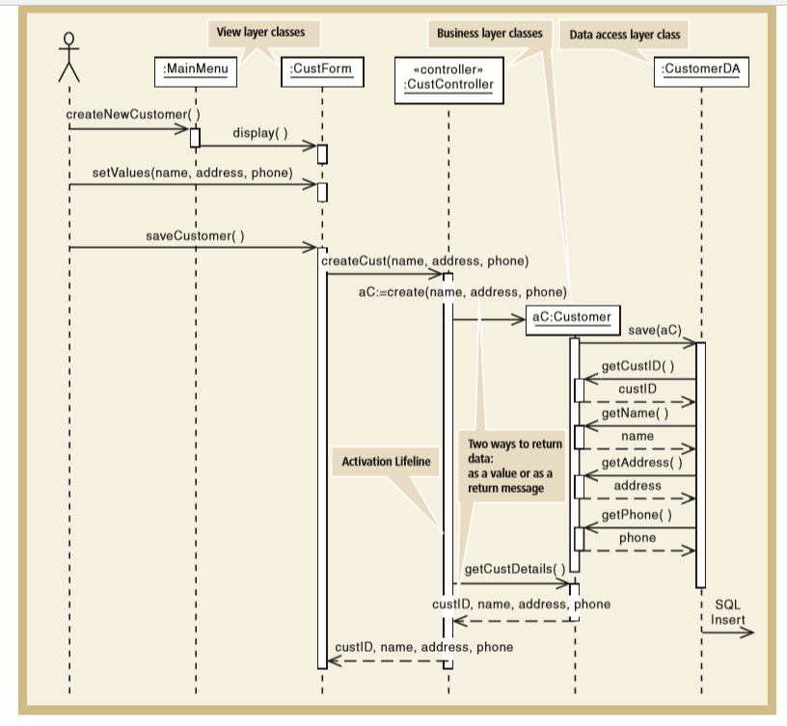
Use Case Realization: Example of a Complete Design Sequence Diagram
View Layer Classes
MainMenu <<boundary>>
CusftForm <<boundary>>
Business Layer Classes
CustController <<control>>
Customer <<entity>>
Data Access Layer Classes
CustomerDA <<dataAccess>>
Satzinger (2011)

Slide 47
Steps for Use Case Realization: Three Refinement Steps
Step 1: Add <<boundary>> classes in sequence diagram for View Layer (already done in analysis but can be added in design)
Step 2: Add <<control>> class in sequence diagram for Business Layer (already done in analysis but can be added in design)
Step 3: Add <<dataAccess>> class in sequence diagram for Data Access Layer

Slide 48
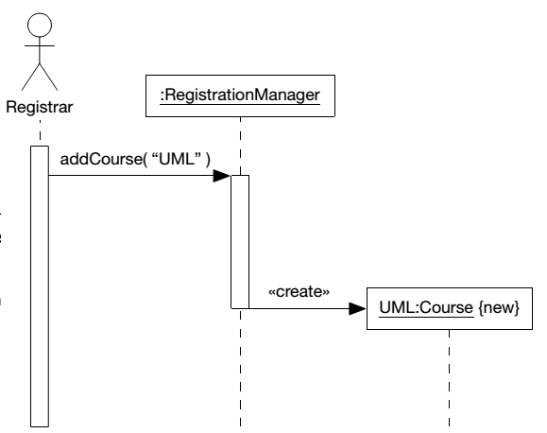
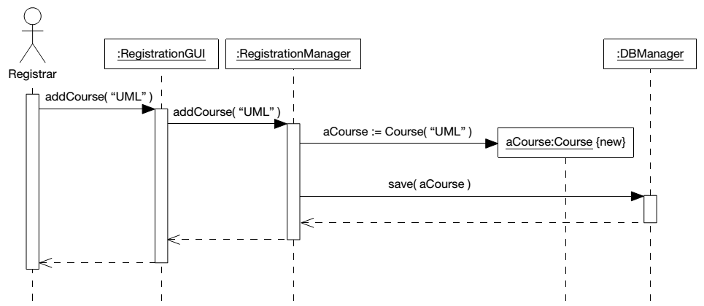
Step 1: Add <<boundary>> classes in sequence diagram
- GUI layer has been added
- Object construction is also shown by an explicit constructor method invocation.
Source: Arlow and Neustadt (2002)

Slide 49
Step 2: Add <<control>> class in sequence diagram
An artifact invented by the designer to handle a system function
Serves as a collection point for incoming messages
Intermediary between the outside world and the internal system
A single use case controller results in low cohesion
Several use case controllers raise coupling but result in high cohesion

Slide 50
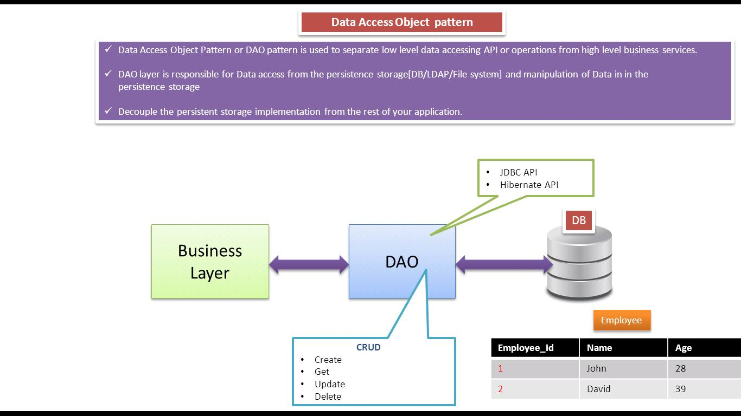
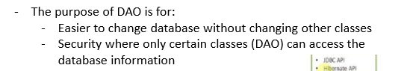
Step 3: Add <<dataAccess>> class in sequence diagram
*Note: Example of implementation:
- Cloud database without sql such as Firebase
- JDBC
Source: https://ramj2ee.blogspot.my/2013/08/data-access-object-design-pattern-or.html#.WtrBjIhuaDJ

Slide 51
Example: Sequence Diagram for Telephone Order
Define a user controller object
Define a “create” message for new Order objects
Customer object creates the Order object
Define other messages
addItem, createOrdItem, getDescription, getPrice, updateQty
Identify source, destination, and navigation visibility for each message

Slide 52
Developing a Multilayer Design for the Telephone Order Scenario
Extend one message at a time
View layer
Open Order window and return a Customer object
Data layer
Customer object initializes itself
Add items to an order with a repeating message
Save Order and OrderItem to the database
Update database inventory
Complete transaction

Slide 53
Sequence diagram with <<control>> and <<entity>> classes only for Telephone Order scenario

Slide 54
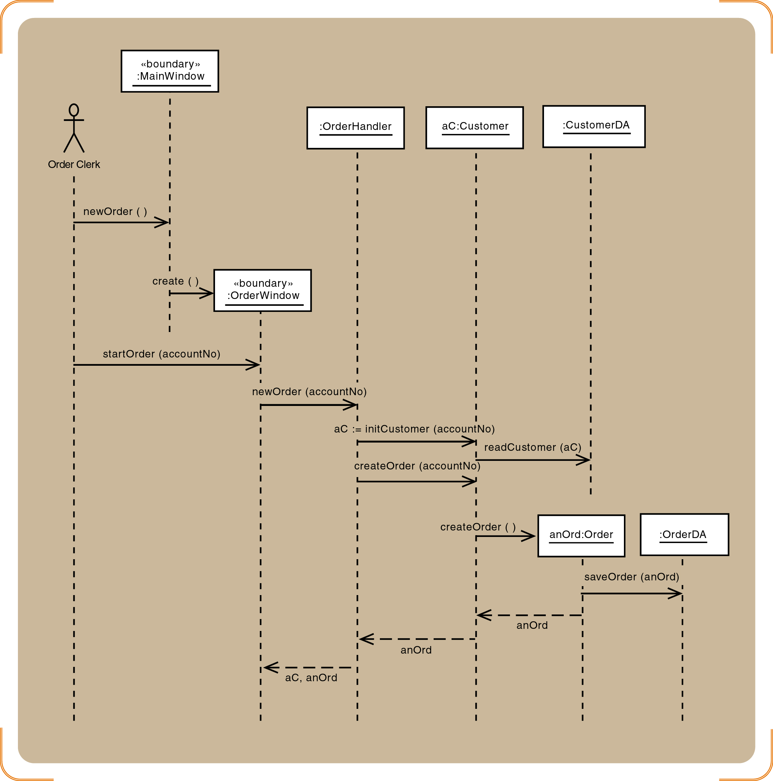
Telephone order sequence diagram for newOrder and startOrder messages - <<boundary>> and <<dataAccess>> classes are added

Slide 55
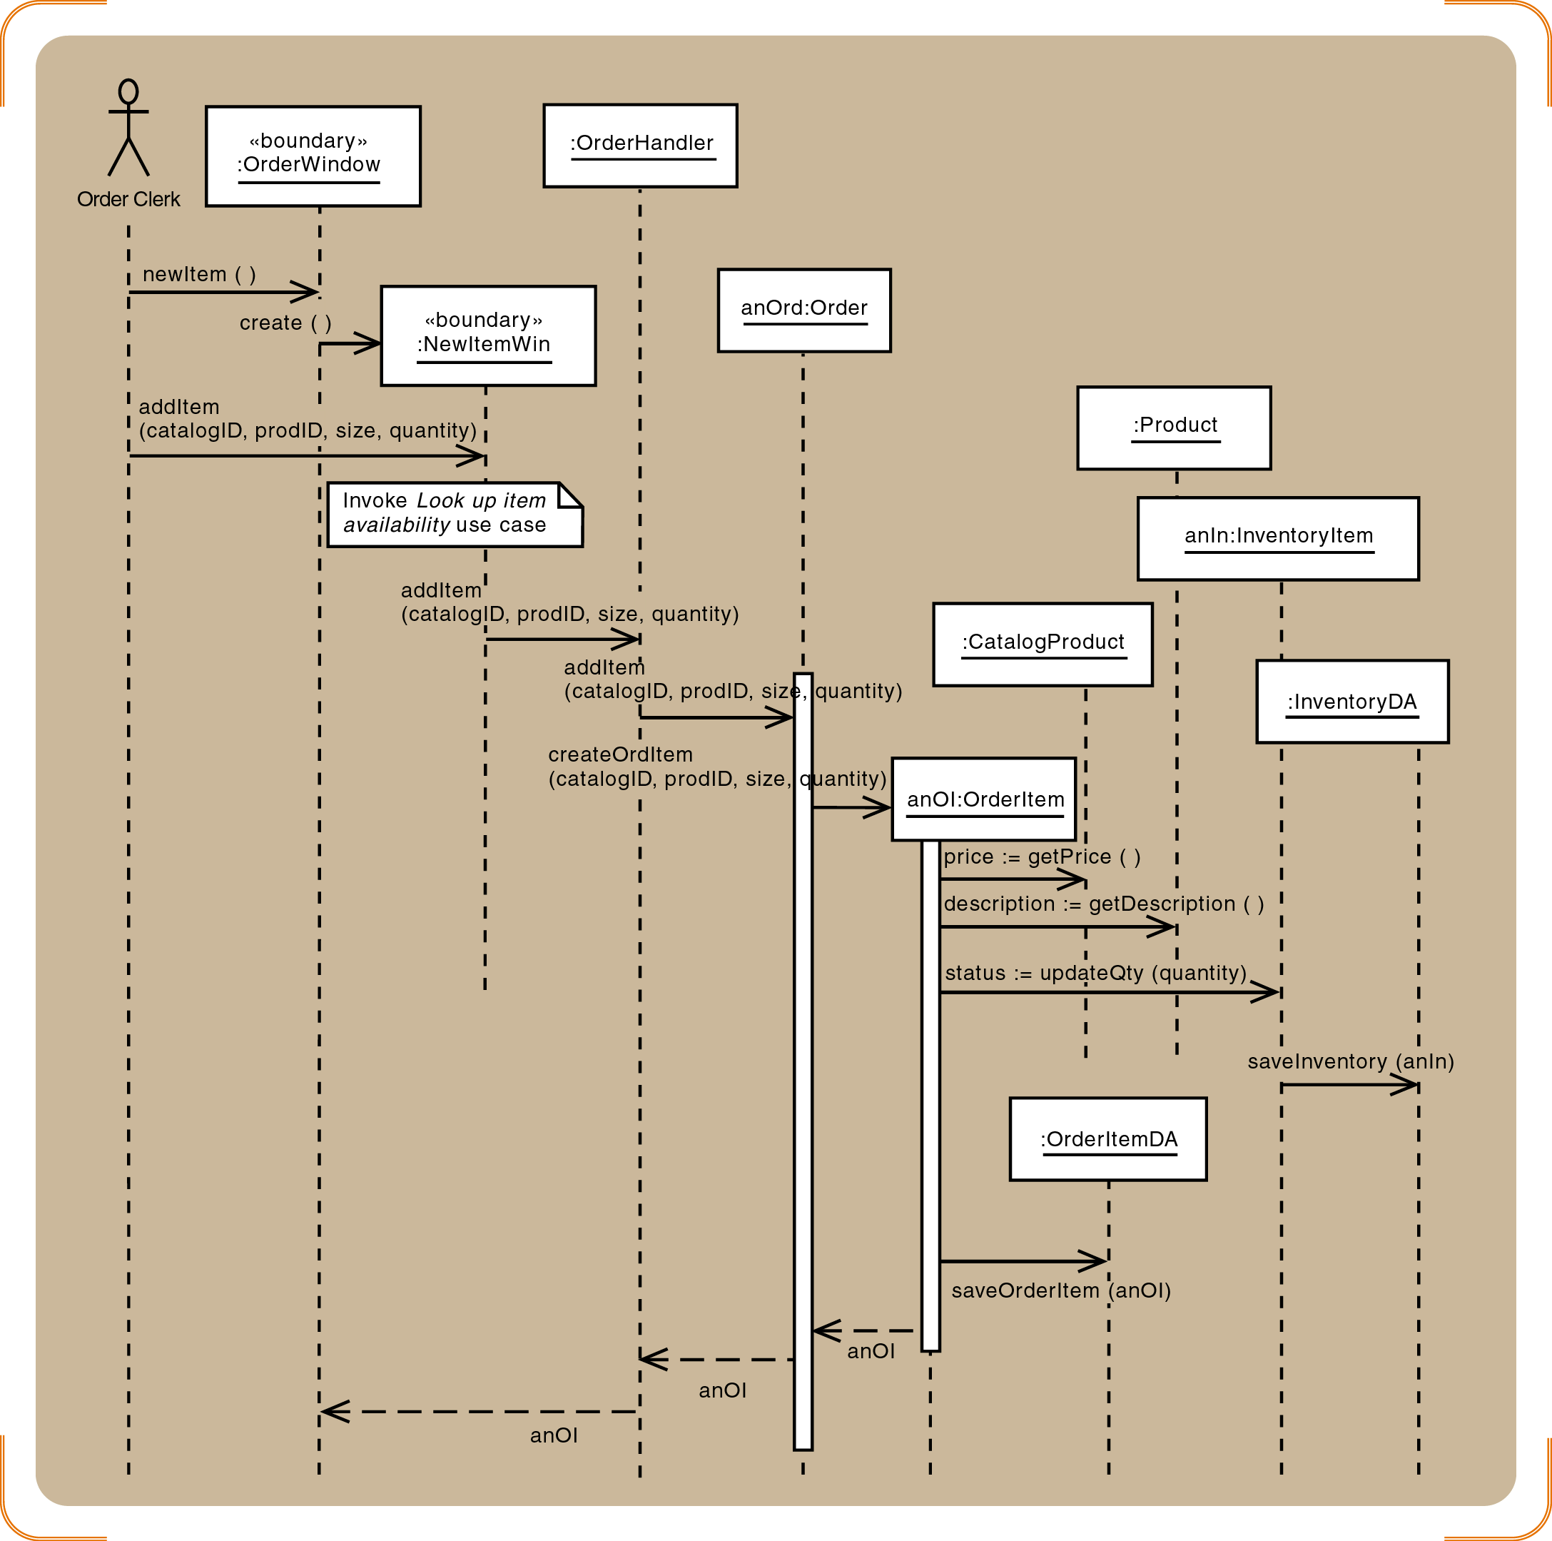
Telephone order sequence diagram for newItem and addItem messages - <<boundary>> and <<dataAccess>> classes are added

Slide 56
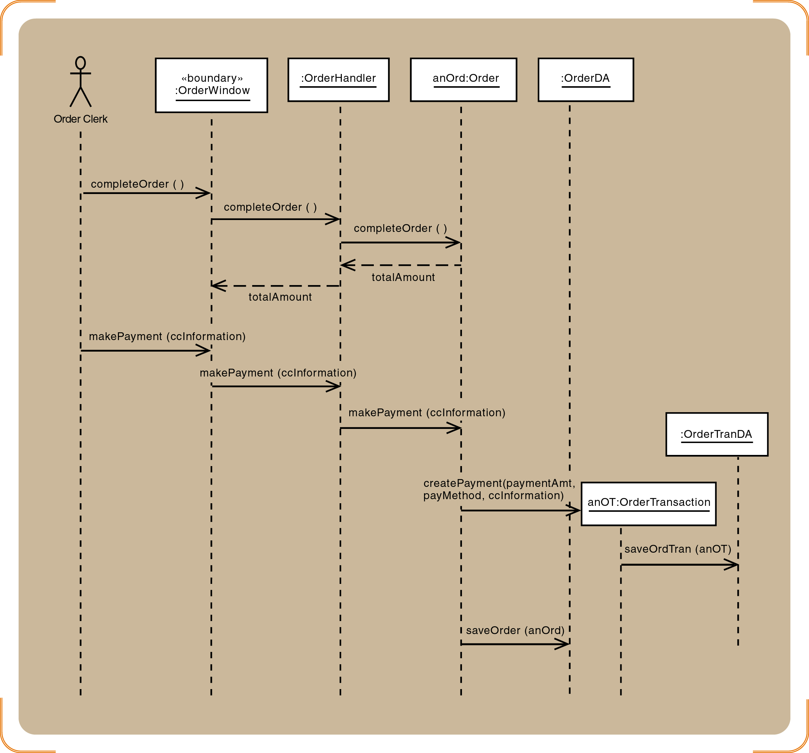
Telephone order sequence diagram for the final messages (complete Order and makePayment) - <<boundary>> and <<dataAccess>> classes are added

Slide 57
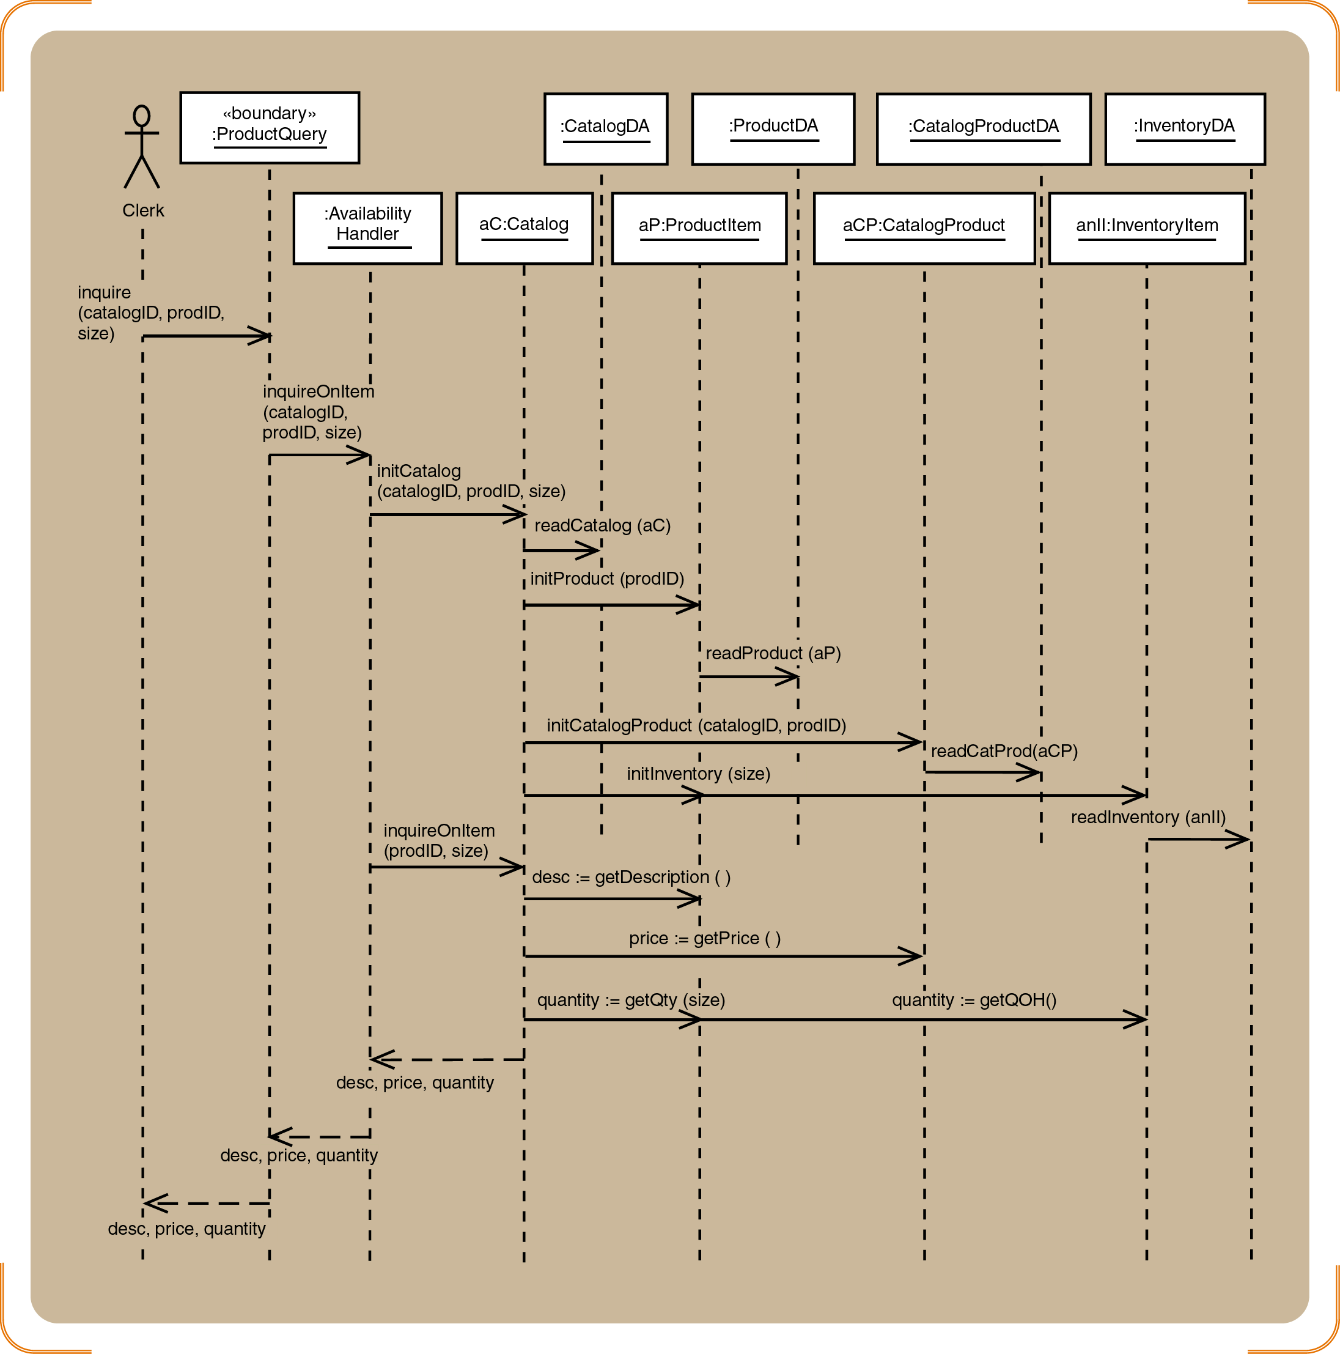
Design sequence diagram after the 3 refinement steps
Example: Completed three-layer design that includes <<boundary>>, <<control>>, <<entity>> and <<dataAccess>> classes for Look up item availability scenario

Slide 58
UPDATE DESIGN CLASS DIAGRAM

Slide 59
Updating Design Class Diagram
Add classes for the view and data access layers
Update classes with method signatures:
Constructor and get and set methods are optional
Use case specific methods are required
Every message in a sequence diagram requires a method in the destination object

Slide 60
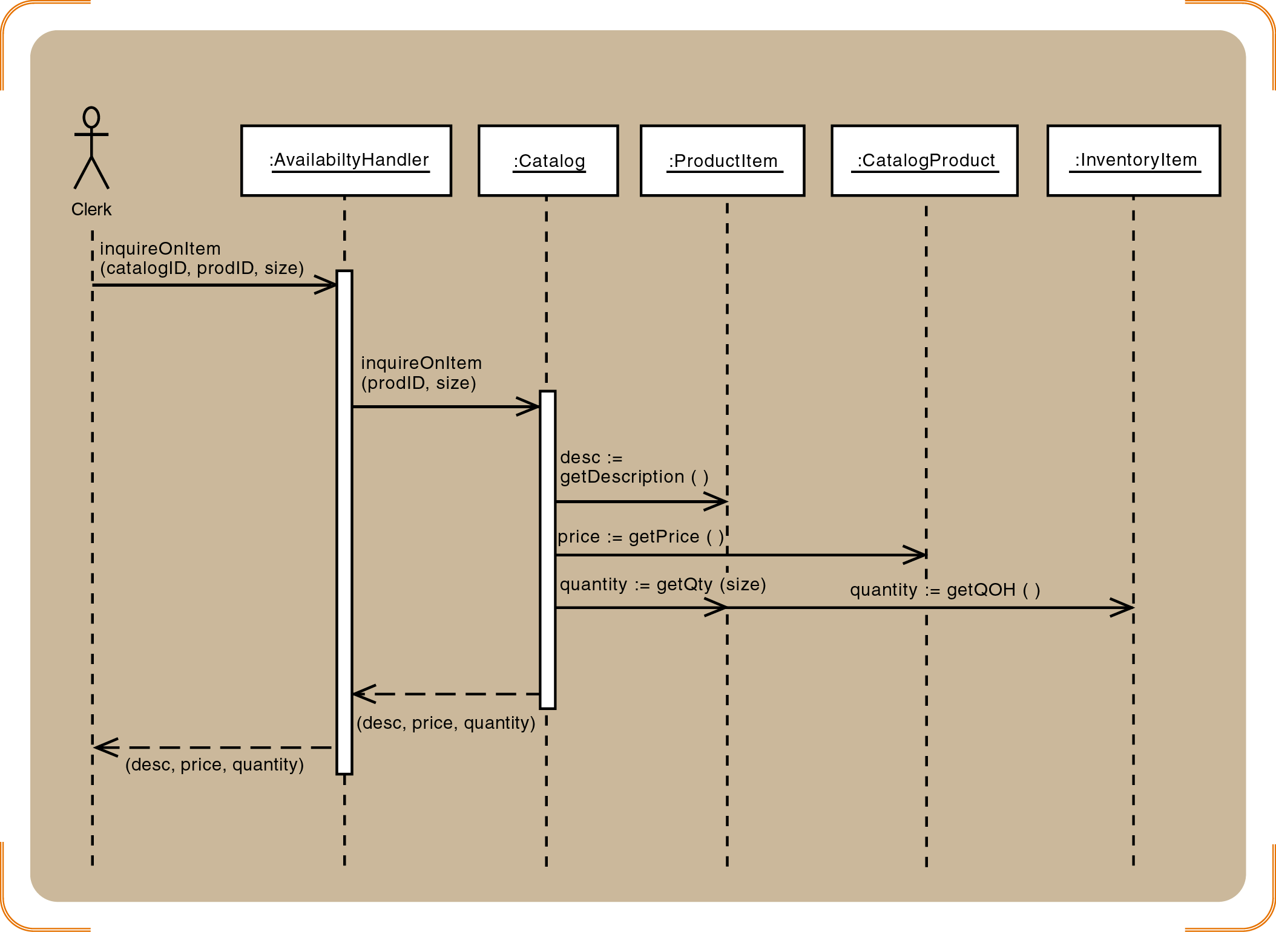
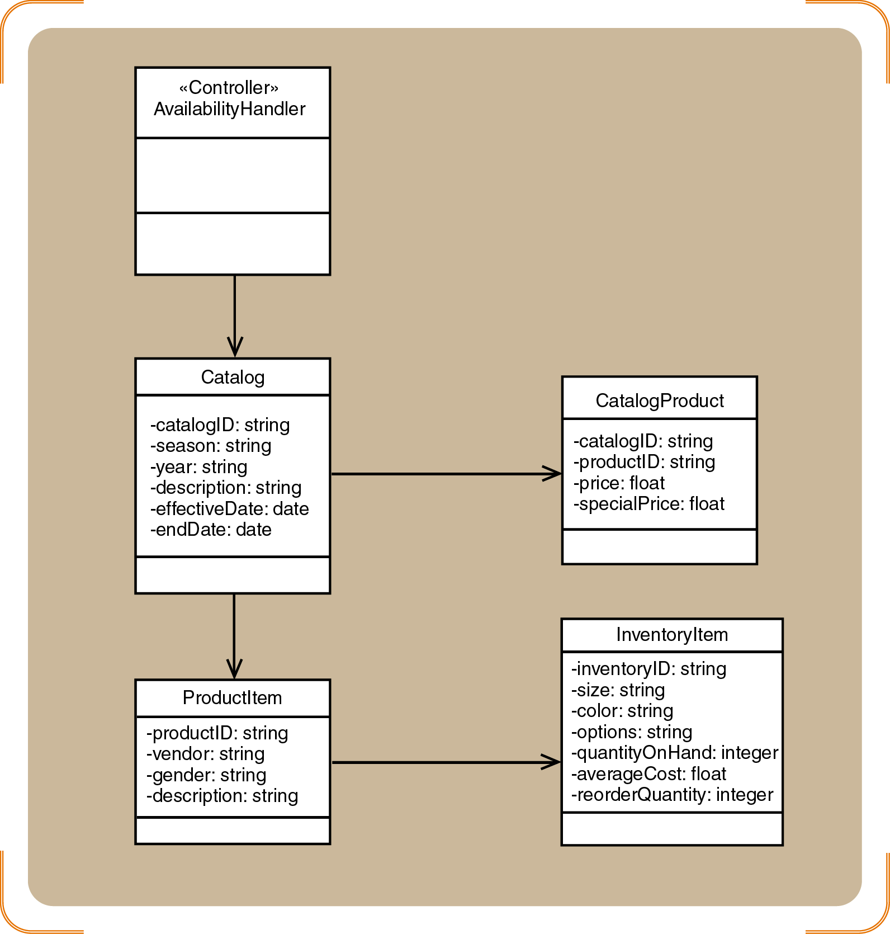
Sequence Diagram vs. Domain Model

Slide 61
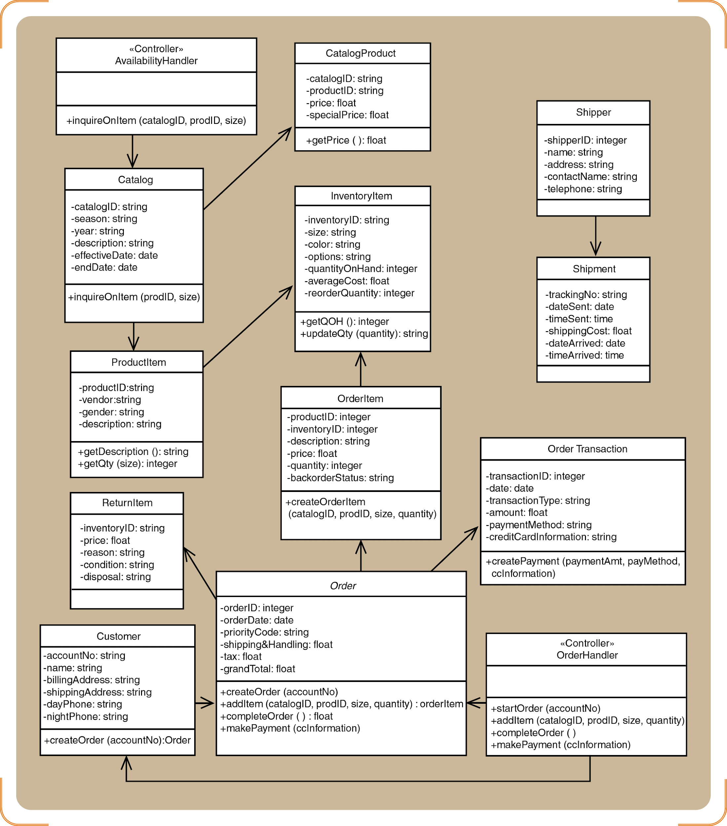
Design Class Diagram vs. Sequence Diagram
Same input message

Slide 62
Data Design
Data design “transforms the information domain model created during analysis into the data structures that will be required to implement the software.”
Take the high-level data model from requirements and refine it into the concrete schema or data structures that the system will use.
https://www.testrail.com/blog/requirements-traceability-matrix/
Notes:
Added Dec 2025

Slide 63
Why Data Design is Important
Structure and Consistency:
A single source of truth eliminates ambiguity.
Implementation and Traceability:
A clear, traceable path from requirement to code.
Performance and Integrity:
An efficient foundation for a robust system.
Clarity and Alignment:
A shared reference that accelerates the team.
Notes:
Added Dec 2025

Slide 64
Process of Data Design
Identify and Model Key Entities: Begin by identifying the key entities or data objects in the system from the analysis models.
Define Attributes and Data Types (Data Dictionary): For each entity identified, list out its attributes and details. This is where you create or update the data dictionary. A convenient way to do this is to prepare a table for each entity that includes all attributes.
Notes:
Added Dec 2025

Slide 65
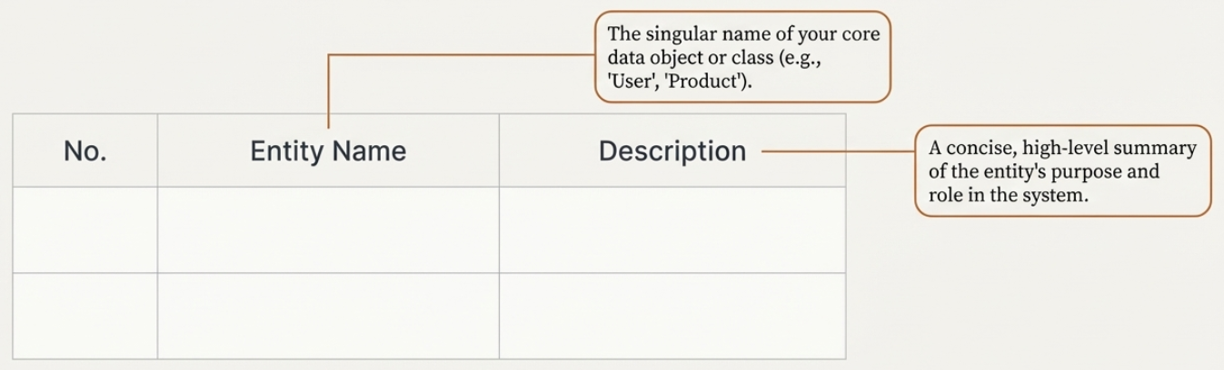
Description of Entities
Notes:
Added Dec 2025

Slide 66
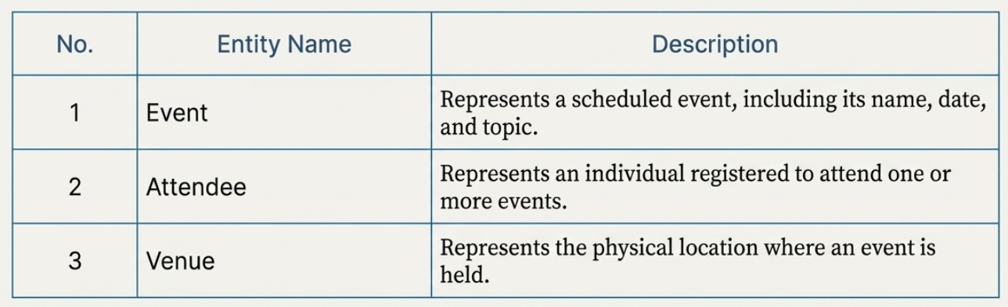
Example: Event Management System
Notes:
Added Dec 2025

Slide 67
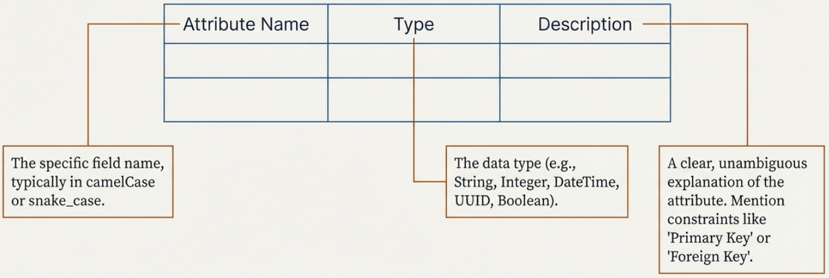
Data Dictionary
Notes:
Added Dec 2025

Slide 68
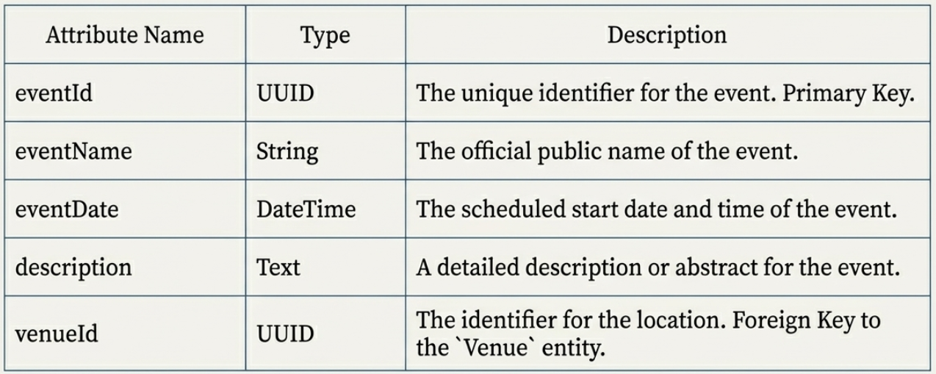
Example: Event Management System (Event Entity)
Notes:
Added Dec 2025

Slide 69
Traceability Matrix
A traceability matrix (TM) is a table that maps and traces user requirements with corresponding elements such as:
Requirement Identifier: A unique ID for each requirement.
Description: A summary of the requirement.
Design Artifacts: References to design documents or components that implement the requirement.
Test Cases: IDs of test cases designed to verify the requirement.
Test Results/Status: The outcome or status of the tests (e.g., pass/fail).
Defects/Issues: Any issues or defects found during testing, linked back to the requirement.
It ensures complete coverage so that all requirements are implemented, tested, and no unnecessary work is done.
Notes:
Added Dec 2025

Slide 70
Traceability Matrix in Plan-Driven
An implementation of traceability matrix in plan-driven is a formal and comprehensive traceability document that is maintained throughout a project.
It links requirements to design to implementation to testing, and finally to deployment according to the predefined project plan.
Notes:
Added Dec 2025

Slide 71
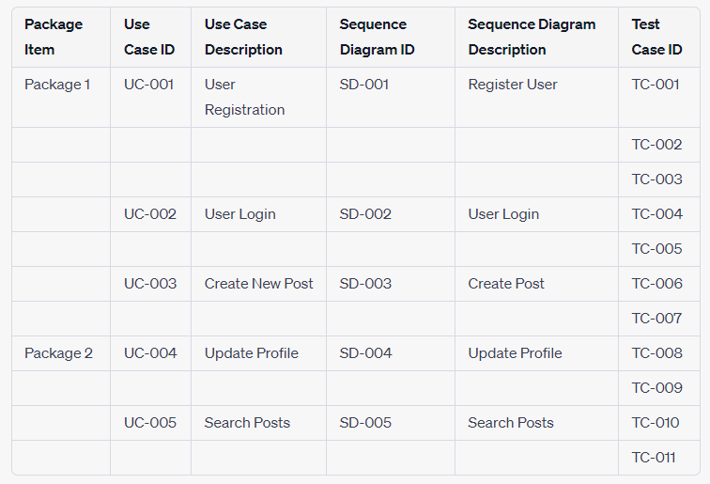
Example of Traceability Matrix in Plan-Driven
Notes:
Added Dec 2025

Slide 72
Agile Requirement Traceability Matrix (ARTM)
The Requirements Traceability Matrix (RTM) is a tool or document commonly used to ensure that all the requirements established for a testing project are mapped to corresponding tests. Think of it as a management framework connecting requirements to design elements, tests, and outcomes.
https://www.testrail.com/blog/requirements-traceability-matrix/
Notes:
Added Dec 2025

Slide 73
How to create a Requirements Traceability Matrix
Define the project’s scope and objectives
Gather and review requirements
Establish naming conventions
Set up your Requirements Traceability Matrix
Fill in the matrix
https://www.testrail.com/blog/requirements-traceability-matrix/
Notes:
Added Dec 2025

Slide 74
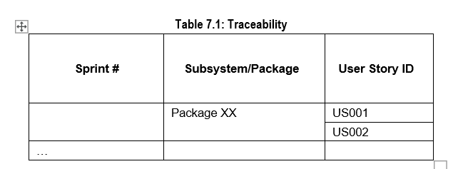
Example: ARTM
Notes:
Added Dec 2025

Slide 75
An Example
Login
Sprint # | Subsystem/Package | User Story ID
1 | Login Interface | US001
 |  | US002
…
Notes:
Added Dec 2025

Slide 76
Key Points
Object-oriented detailed design is a low level design involves the identification and description of sets of objects that must work together for each use case
Fundamental design principles include encapsulation, object reuse, information hiding, navigation visibility, cohesion, coupling and separation of responsibilities
Models involved in detailed design from analysis stage are class diagram and sequence diagram
Classes with related resonsibilites should be grouped in a package as a subsystem of the system

